Slide 1
AutoMARK
By: Owen Stadlwieser

Slide 2
What is AutoMARK
AutoMARK is a tool used to grade entry level drafting assignments
AutoMARK performs a comparison between student assignments and an assignment key, and, assigns a grade based on given feature weights

Slide 3
Benefits of using AutoMARK
AutoMARK can run on a full class size ~100 students and provide a full markup and recommended grades within an hour
AutoMARK saves grading time for instructors allowing them to focus on educating their students and other projects
AutoMARK provides a fair grade instead of having multiple instructors mark assignments

Slide 4
How AutoMARK works
AutoMARK is designed to correct student submissions that are trying to replicate an assignment key
AutoMARK pulls all the information out of student submissions and the key and performs a comparison
For each feature on the student drawing AutoMARK will search the key and find the feature the student was trying to copy
Once it has found a match it compares all of the criterion which this feature is made of and deducts points accordingly

Slide 5
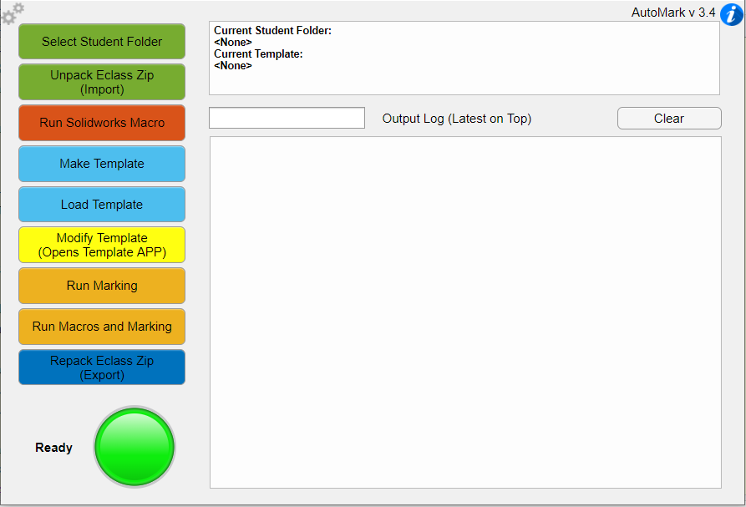
Main User Interface
Settings
Access to app functions
Information

Slide 6
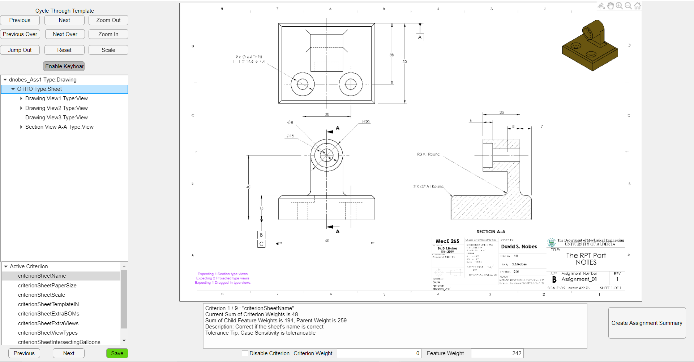
Template UI
Feature Selector
Key Template
Criterion selector
Create assignment summary
Criterion information

Slide 7
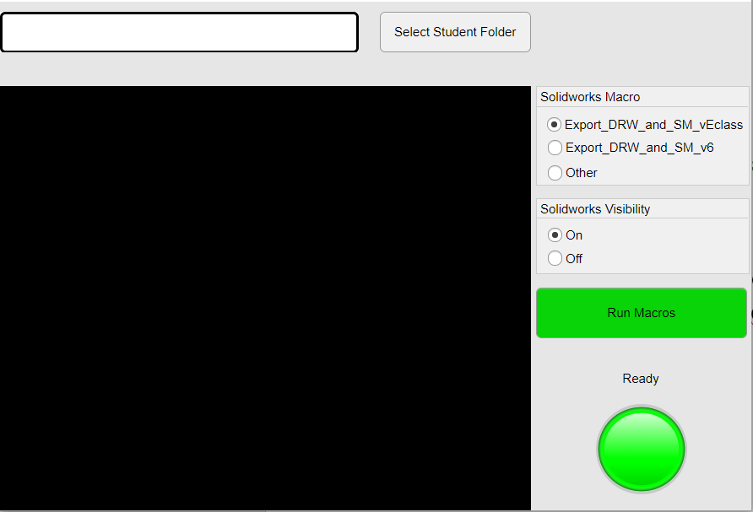
Running Macros UI

Slide 8
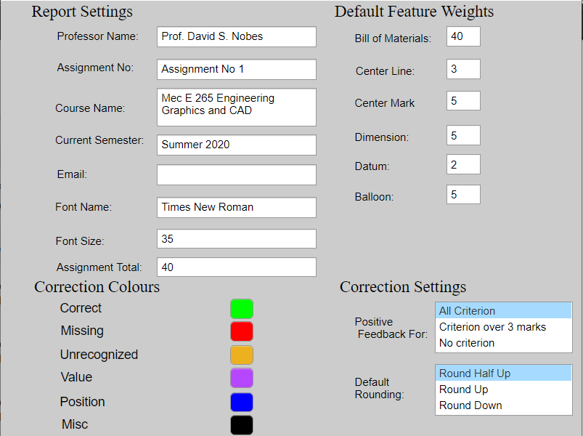
Settings UI

Slide 9
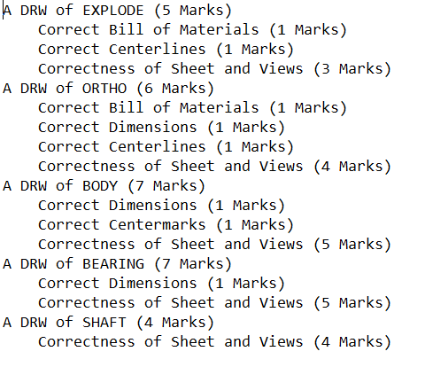
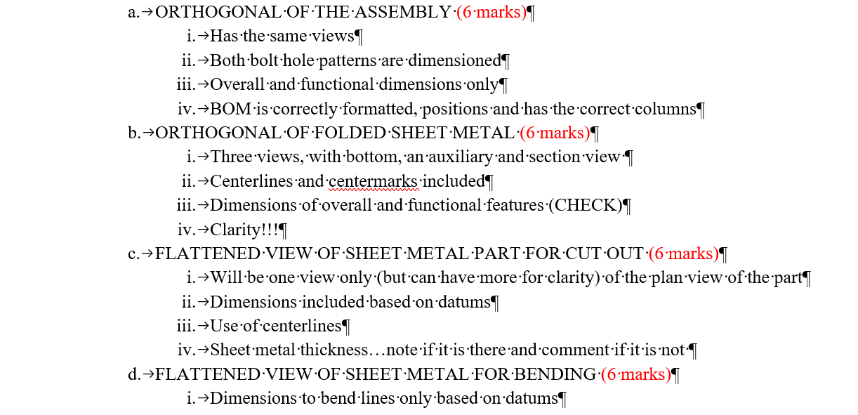
Creating an assignment summary
An assignment summary can give the instructor insight into how they should structure their rubric
The instructor should try to match the rubric with the AutoMARK assignment summary if they are assigning students their AutoMark grades

Slide 10

Marking analysis
The following slides demonstrate the validity of the AutoMARK grading system
The analysis was done by plotting a students given grade on the y-axis and their AutoMARK score on the x-axis
In general the grades agreed with each other with the AutoMARK system being harsher in some cases
Using the AutoMARK modify template interface the grader can give leeway to students. I used this in some cases to align the AutoMARK score with the TA’s grades

Slide 11
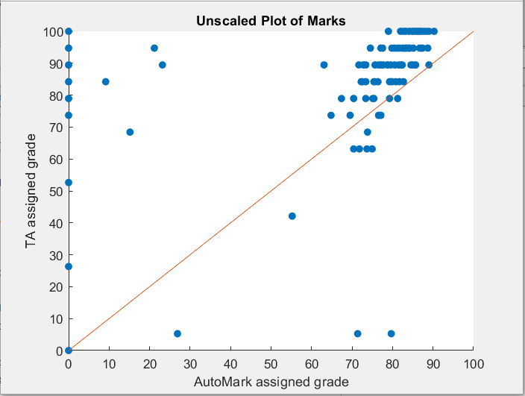
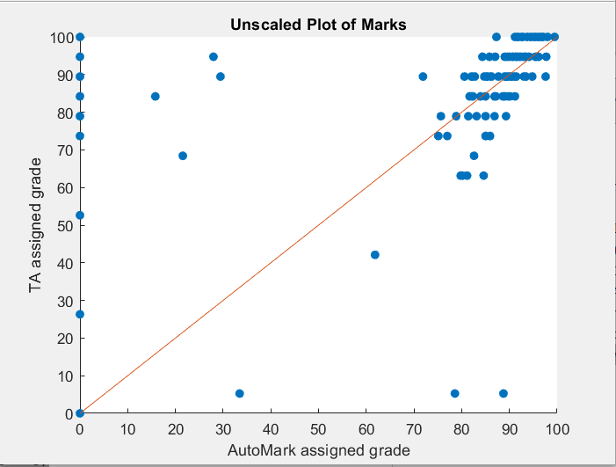
Assignment 3
Plots demonstrate the correlation between the TA grade and AutoMARK grade. Most students are close to the orange line which demonstrates equal TA and AutoMARK grades.
AutoMARK Crash, most bugs causing crashes have been corrected
Multiple files submitted AutoMARK only corrects one file
Unboosted Assignment
Assignment with 7% boost
Grade input error in TA sheet

Slide 12
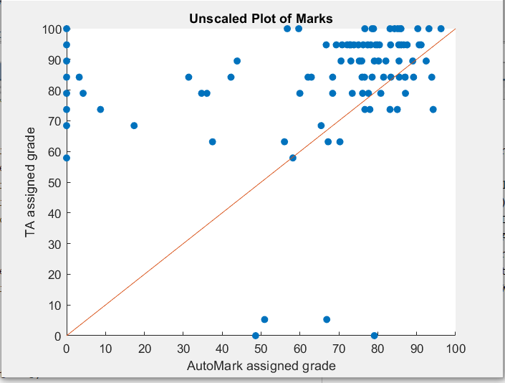
Assignment 4
Many students forgot to hand in sheets, AutoMARK took away more marks than TA’s for missing sheets. Most students still lie near the x = y line.
Forgot to hand in sheets

Slide 13
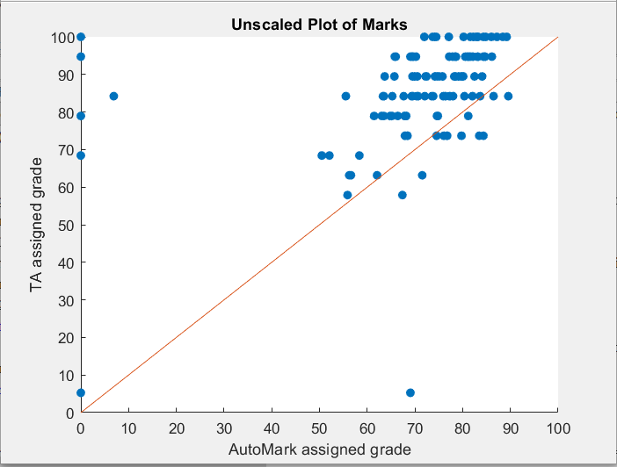
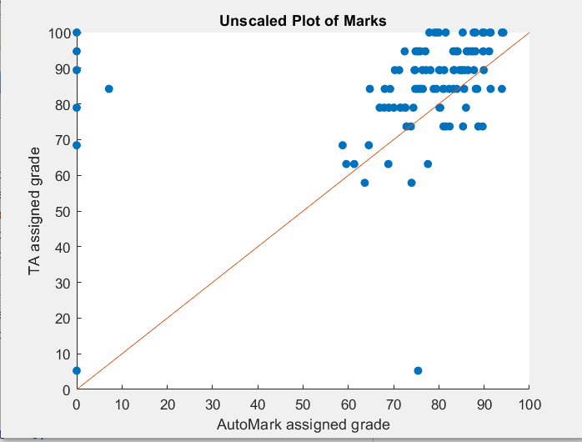
Assignment 5
In this case there was one sheet where the average was significantly below the other sheets, so I added a boost in marks by assigning 50 points to the criterionAlwaysWrong sheet criterion. Sheet grades are visible in the class report pdf.
Unboosted Assignment
Assignment one sheet given a 50 point boost

Slide 14
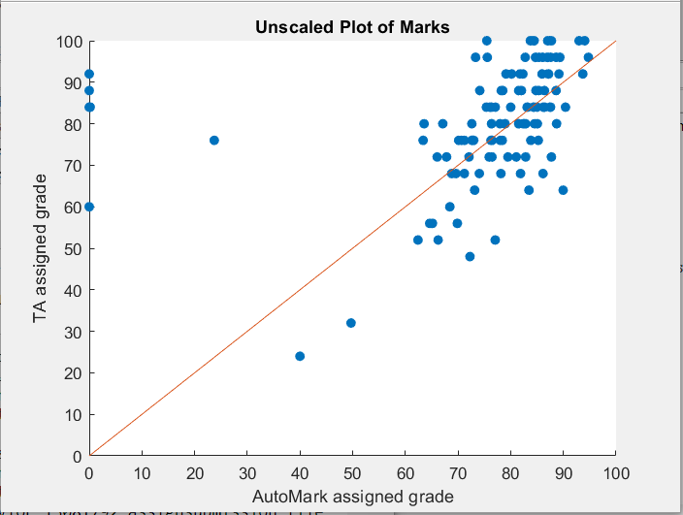
Assignment 6
This assignment had a fair distribution and needed no changes

Slide 15
Conclusions from analysis
AutoMARK can generate fair grades for students
The distribution of the AutoMARK grades is similar to the distribution of the TA grades in most assignments
In some assignments such as assignment 5 a better grade distribution can be achieved by giving students leeway with the criterionAlwaysWrong or rounding up the score once it is scaled down
A more accurate rubric can be generated by using the generate marking summary feature in the Modify Template application

